Slide 1
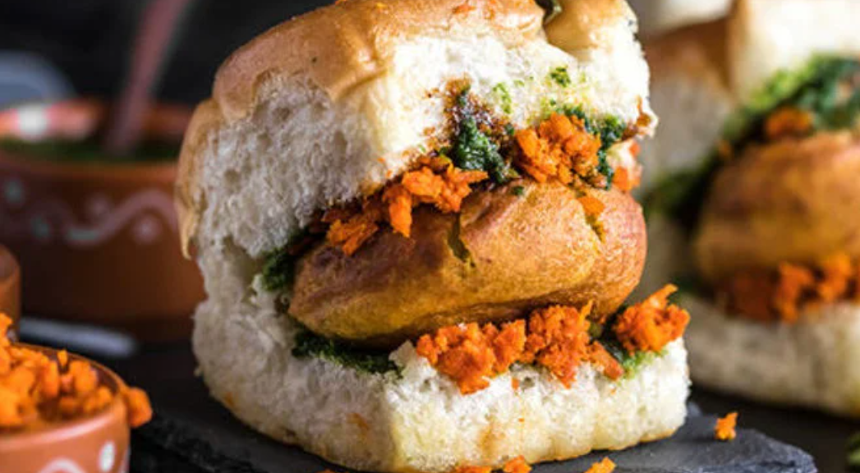
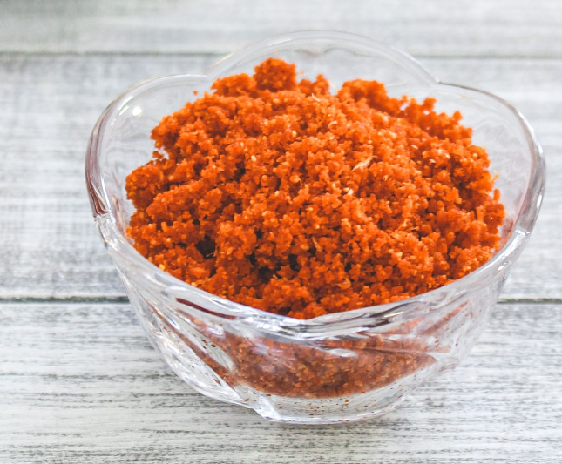
CASE STUDY-VADA PAV
(A study for the new Vada pav shop in the Shivaji Nagar, Pune)
Presented by
Ms. Pooja Savla
Presented By
Pooja Savla

Slide 2
Agenda
Introduction
Problem Statement
Competitors Analysis
Solution Description :
Pricing
Differentiation
Positioning
Impact

Slide 3
Introduction
A man wants to open a Wada Pav Shop near Shivaji Nagar in Pune. He has got a location where there are other 4 more Wada Pav shops.
Problem Statement
To understand the strategy to take over his clients.
What will be the price of each Wada Pav?
How will he differentiate from the other competitors?
Why will be the Customer comes to your shop? (What will be the positioning)
How will you come to a solutions which will make him an entrepreneur and will help him to grow.?

Slide 4
Competitors Analysis
Strength
strong market position
Strong Customer base
Some of the outlets have Innovative Concepts
Weakness
Poor Service
Higher price of the Wada Pav compared to taste
Hygiene Issues
Ambience of Most of the Wada Pav outlets is Mediocre

Slide 5
Pricing
Solution Description :
Competitors Price
Initial Price

Slide 6
Differentiation
Amenities
Dine-in options
Unique Ambience
Delivery
Online delivery
Home delivery
Social Media Platform
Promotions on various social media Platform
Parking Available
Quick Service
Zomato, Swiggy, etc
Multiple Payment options like UPI, Gpay, etc
Just dial
Orders through various platforms

Slide 7
Positioning
Good Quality Food with multiple variety
Affordable to all the groups of people
Mainly Student, employees, Middle Class.
Clean and hygienic Food
Low price with best Quality compared to others
Best Services & Amenities compare to others

Slide 8
Thank You

